Slide 1

House Sales Price Prediction ML Model
Balaji Dilip Madgulwar

Slide 2
House Sales Price Prediction ML Model
I have explored the Housing data for the residential homes resides in Ames City Present of Iowa State in the Midwestern United States .
I have applied the Numpy and Pandas library available in python for getting out the meaningful insights from the dataset.
I have applied the Seaborn ,Matplotlib visualization library for plotting the beautiful and meaningful graph for better understanding the relationship between the different Variables.
I have used the Pandas Profiling library for finding out the missing values present in the dataset for filling those missing values with appropriate values for the particular feature/column.
I have used different Regression ML model for predicting the salesprice of the house for the given dataset.
I have created the GUI for predicting the Salesprice of the house with the help of tkinter python library using Linear Regression OLS method.
Finally I have captured the observation and summarized into the conclusion section.

Slide 3
House Sales Price Prediction ML Model
The dataset consists of the information of various attribute/feature that decide the SalePrice of the residential Homes Ames City of Iowa State with 1460 observations and 81 columns.
Below table will give the explanation of few important column present in the given dataset have a good correlation with SalePrice value.
Column Name | Description
SalePrice | the property's sale price in dollars.
GarageArea | Size of garage in square feet
1stFlrSF | First Floor square feet
2ndFlrSF | Second floor square feet
TotalBsmtSF | Total square feet of basement area
GrLivArea | Above grade (ground) living area square feet
GarageArea | Size of garage in square feet
Neighborhood | Physical locations within Ames city limits

Slide 4
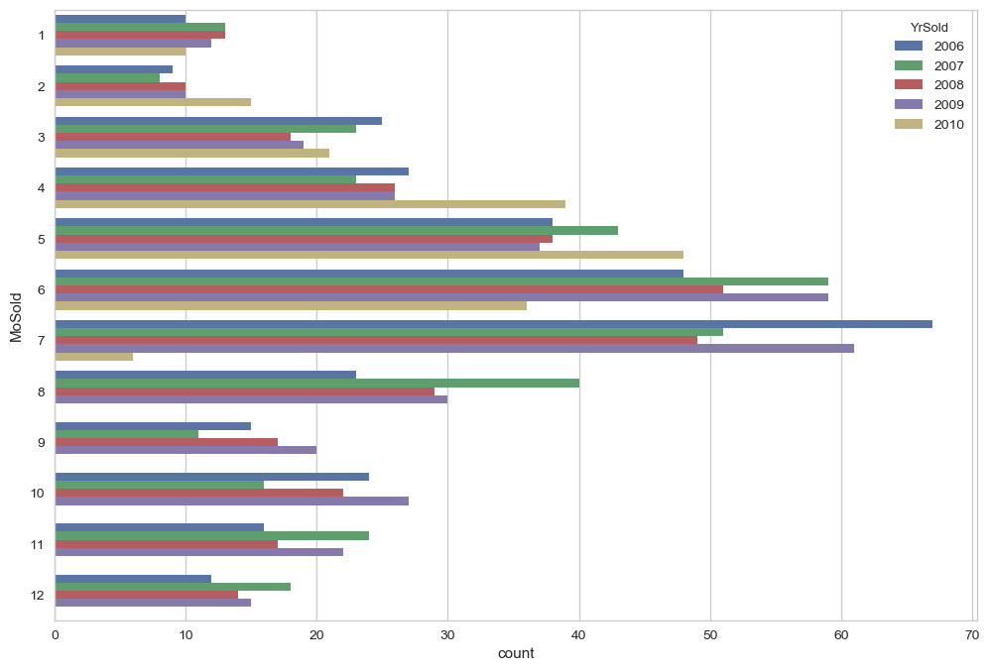
House Sales Price Prediction ML Model
Relation between MoSold and YrSold feature
We can see that during the Month of June and July there is an increase in selling of the house for the 2006 to 2010 year.

Slide 5
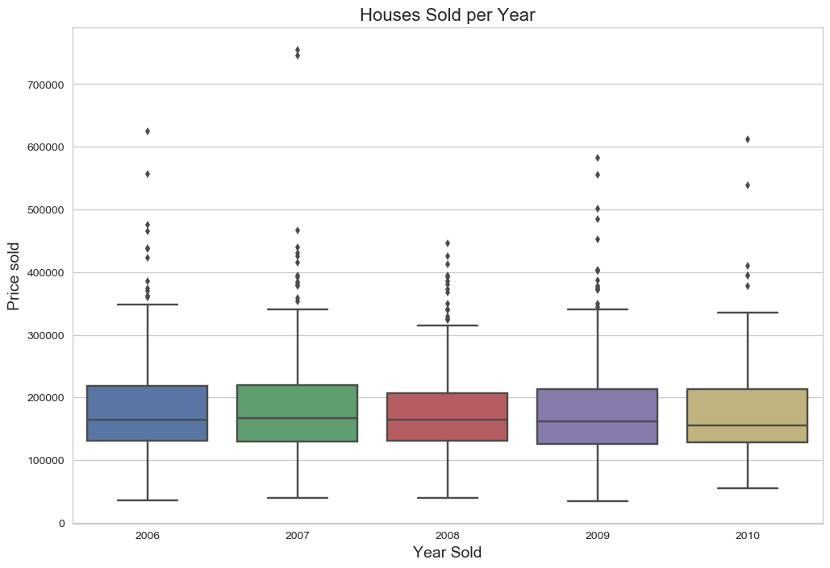
House Sales Price Prediction ML Model
Relation between YrSold and SalePrice feature
We can observe that in the year 2007 there is an increase in the selling price of the house with respect to other years.

Slide 6
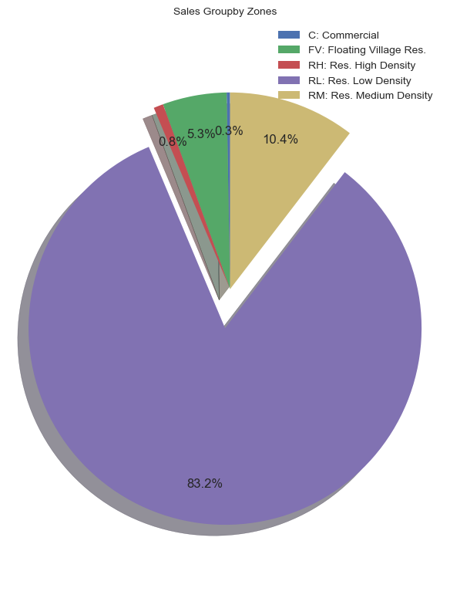
House Sales Price Prediction ML Model
Distribution of SalePrice with respect to Type of Zoning
Most of the SalePrice values are determined by Residential Low Density type of zoning.

Slide 7
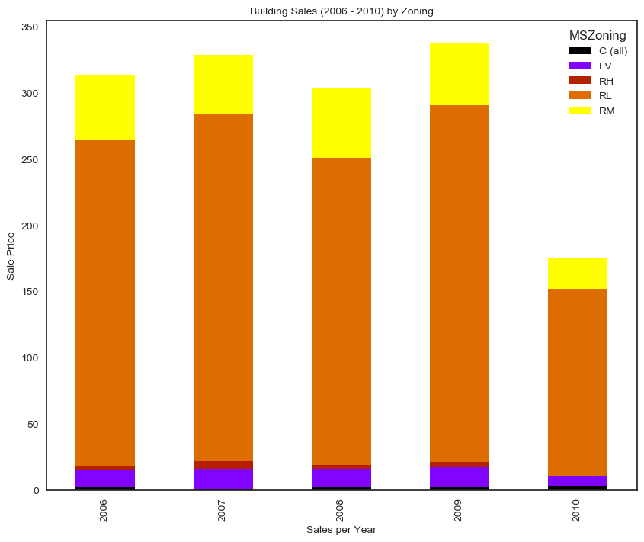
House Sales Price Prediction ML Model
Distribution of SalePrice with respect to Type of Zoning and selling year
During the 2006-2010 year the Residential low Density type of zoning affect the SalePrice of the House.

Slide 8
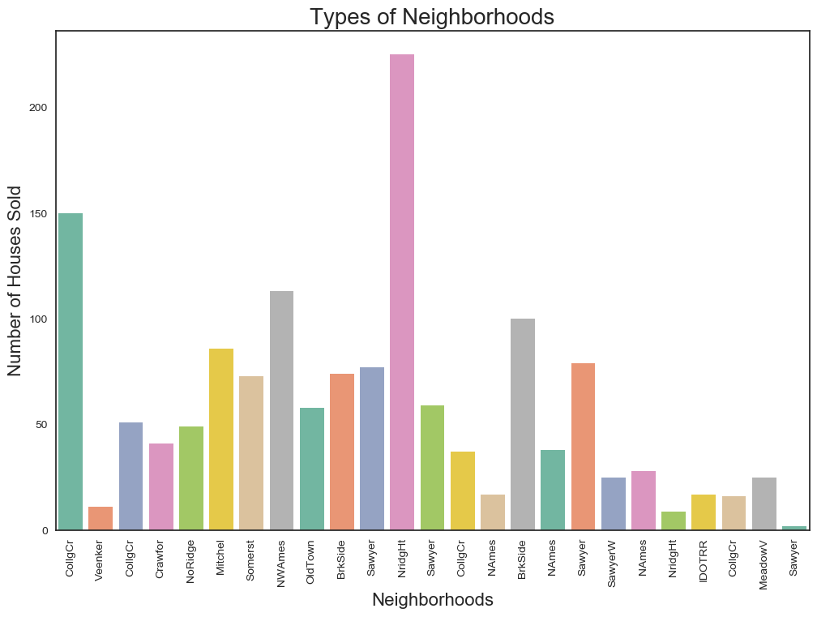
House Sales Price Prediction ML Model
Distribution of Neighbourhood feature
In the Nridght Neighborhoods more than 200 houses are sold which is highest with respect to other Neighborhoods.

Slide 9
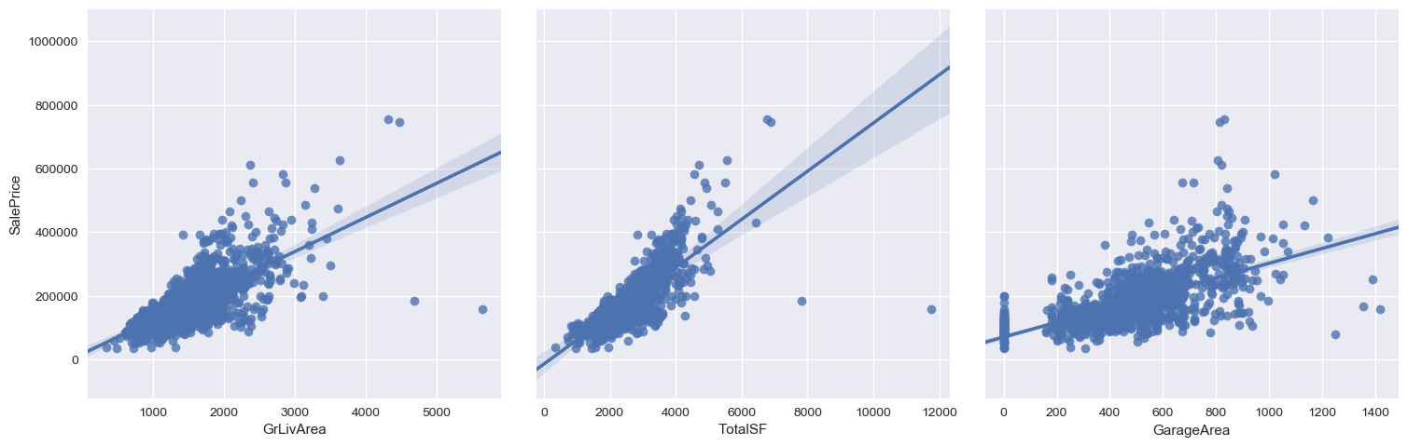
House Sales Price Prediction ML Model
Distribution of Input Feature Variable with respect to Target Variable
We can observe that SalePrice have a stronger relationship with TotalSF than GrLIvArea and GarageArea as the line passes through most of the TotalSF Datafield values (datapoint).

Slide 10
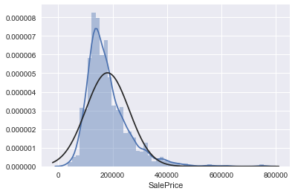
House Sales Price Prediction ML Model
Distribution of SalePrice feature (Target variable)
We can see that the target variable (SalePrice) is rightly skewed.

Slide 11
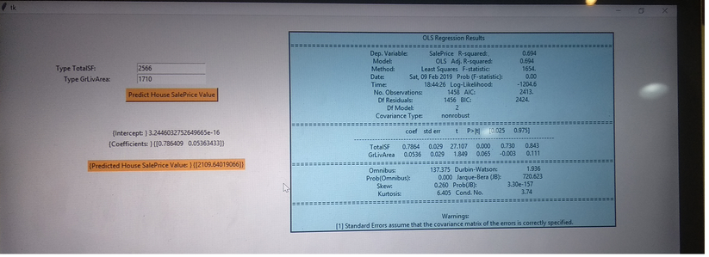
House Sales Price Prediction ML Model
Graphical User Interface for SalePrice Prediction Using Tkinter
We can see the GUI build using Tkinter with the help of Input feature TotalSF and GrLivArea we can predict the SalePrice Value of the House (Linear Regression OLS method)

Slide 12
House Sales Price Prediction ML Model
Evaluation Metrics for Various Regression Model
Model Name/Metrics | RMSE Score (Test Data) | R2 Score (Test Data)
Linear Regression | 0.48475 | 0.7503
Linear Regression with Gridsearch CV | 0.2349 | 0.7503
Linear Regression with OLS Method | NA | 0.694
Random forest Regression with Gridsearch CV | 0.489 | 0.725
Random forest regression with Best parameter | 0.508 | 0.725
Decision Tree Regression with Gridsearch CV | 0.451 | 0.707
Decision tree Regression with Best Parameter | 0.508 | 0.707

Slide 13
House Sales Price Prediction ML Model
Conclusion :
There are several factors that impact the overall price of the house, some of those factors are more tangible as the quality of the house or the overall size (area) of the house and other factors are more intrinsic such as the performance of the economy.
Out of 81 Variables ,we can see that SalePrice have a good correlation score with GrLivArea (Area above the ground level), TotalSF (total floor (1st,2nd and total Basement floor) square feet) ,GarageArea (Size of GarageArea).
Linear Regression with Gridsearch CV Model is best model for the SalePrice of the House as RMSE score is less i.e. 0.2349.
Note : I will build Stacking Regression model for salePrice prediction of house after completion of Intermediate and Advanced ML concepts.

